Slide 1
Adaptive Computer Technologies MR22-1ES0104 L-2, P-2, C-3
By
V. Gopi Tilak,
Assistant Professor,
Department of CSE,
School of Engineering,
Malareddy University

Slide 2
Chapter 5- Data Science and Google Technologies
Data Science:
Data-Information-Knowledge
Databases - Data warehouse - Big Data
Supervised learning, Unsupervised learning, Reinforcement learning with respect to Data mining - Machine Learning - Artificial Intelligence - Deep Learning
Real time applications on AI/ML/DL/DS
Casestudy-5: Prepare a PPT/Poster about the future scope of AI/ML/DL/DS in various fields
Google Technologies:
Google Search Engine, Google Sheets, Google documents, Google forms, Google Drive
Casestudy-5: Conduct a survey using Google forms and generate pictorial reports using Google sheets

Slide 3
Data-Information-Knowledge
Data: Data are the raw alphanumeric values obtained through different acquisition methods. Data in their simplest form consist of raw alphanumeric values.
Unstructured facts and figures that have the least impact on the typical manager.
Information: is created when data are processed, organized, or structured to provide context and meaning. Information is essentially processed data.
Information thus paints a bigger picture; it is data with relevance and purpose.
Knowledge: is what we know. Knowledge is unique to each individual and is the accumulation of past experience and insight that shapes the lens by which we interpret, and assign meaning to, information.
For knowledge to result in action, an individual must have the authority and capacity to make and implement a decision. Knowledge (and authority) are needed to produce actionable information that can lead to impact.
https://internetofwater.org/valuing-data/what-are-data-information-and-knowledge/#:~:text=Data%20in%20their%20simplest%20form,Knowledge%20is%20what%20we%20know.

Slide 4
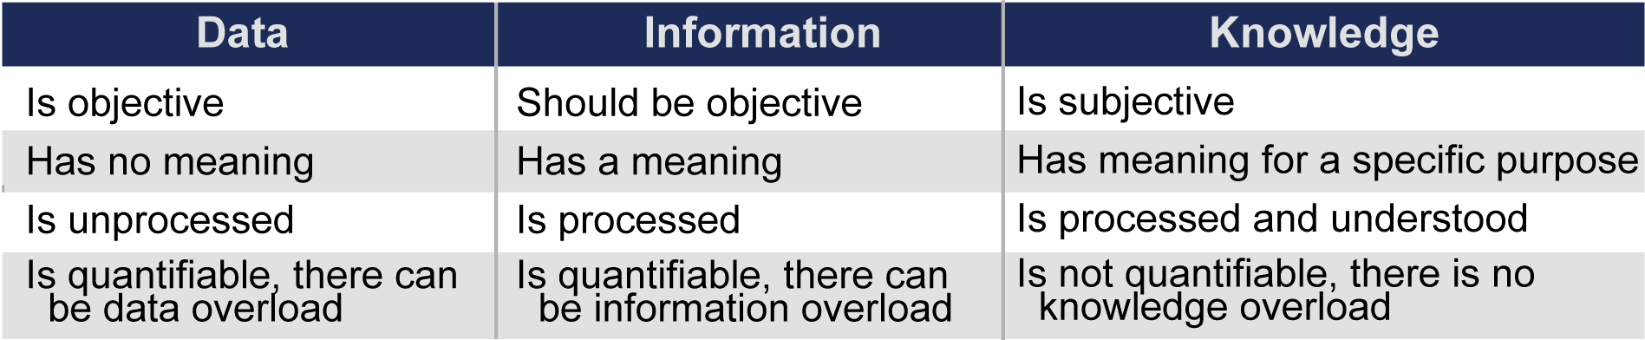
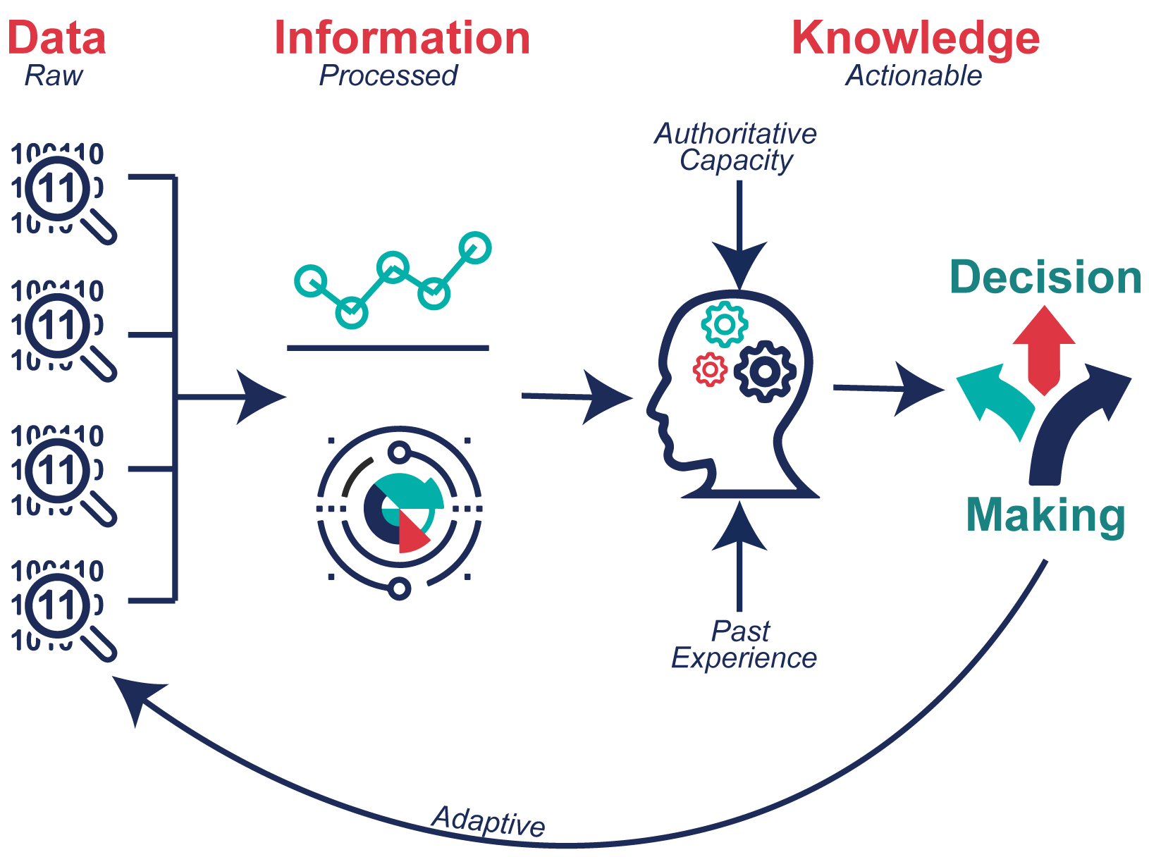
Data-Information-Knowledge

Slide 5
Data bases-Data warehouse- Big data
Data base:
Data base is a collection of data that is organized in a way that makes it easy to store, retrieve, and update. They can be used to store all sorts of data, including customer information, product data, and financial data. In the context of Google technologies, Google Cloud provides several database options, including:
Cloud SQL: A fully managed relational database service compatible with MySQL, PostgreSQL, and SQL Server.
Cloud Spanner: A globally distributed, horizontally scalable, and strongly consistent relational database service.
Firestore: A NoSQL document database that provides real-time data synchronization and offline support for web and mobile applications.

Slide 6
Data bases-Data warehouse- Big data
Data warehouses: They are a type of database that is specifically designed for storing large amounts of data. They are often used to store data that is collected from a variety of sources, such as customer transactions, sensor data, and social media data. It is designed for reporting, analytics, and decision-making purposes. In the Google ecosystem, Google BigQuery is the primary data warehouse offering. BigQuery is a fully managed, serverless, and highly scalable data warehouse that allows you to run fast and cost-effective SQL queries over vast amounts of data. It supports both structured and semi-structured data formats.
Big data: It is a term used to describe data sets that are so large or complex that they are difficult to process using traditional data processing methods. Big data can be used to gain insights into customer behavior, identify trends, and make predictions. In Google's ecosystem, several tools are available for processing and analyzing big data:
• Google Cloud Storage: A scalable object storage service that can store and retrieve large amounts of unstructured data, such as files and backups.
• Google Cloud Dataproc: A managed service for running Apache Hadoop and Apache Spark, which enables distributed processing of big data workloads.
• Google Cloud Dataflow: A fully managed service for building and executing data processing pipelines using popular frameworks like Apache Beam.
• Google Cloud Pub/Sub: A messaging service that allows you to ingest and process streaming data in real-time.

Slide 7
Data bases-Data warehouse- Big data
Applications of Databases - Data warehouse - Big Data
• Customer relationship management (CRM): Databases are used to store customer data, such as names, addresses, and purchase history. This data can be used to track customer interactions, identify trends, and provide personalized service.
• Fraud detection: Data warehouses are used to store large amounts of data, such as financial transactions and customer information. This data can be used to identify fraudulent transactions and prevent fraud.
• Risk management: Big data is used to assess risk and make better decisions. For example, big data can be used to predict customer churn, identify potential problems with products, and assess the risk of natural disasters.
• Healthcare: Data warehouses are used to store patient data, such as medical records and test results. This data can be used to improve patient care, identify trends, and develop new treatments.
• Retail: Data warehouses are used to store sales data, such as product sales and customer demographics. This data can be used to improve inventory management, identify trends, and target marketing campaigns.
• Manufacturing: Data warehouses are used to store production data, such as machine performance and product quality. This data can be used to improve efficiency, identify problems, and improve product quality.
• Financial services: Data warehouses are used to store financial data, such as customer transactions and market data. This data can be used to improve risk management, identify fraud, and make better investment decisions.
• Business Intelligence and Analytics: Organizations use data science and Google technologies to gain insights into their operations, customer behavior, and market trends. By leveraging databases, data warehouses, and big data tools, they can analyze large datasets, perform advanced analytics, and generate reports and visualizations to make data-driven decisions.
• Internet of Things (IoT) Analytics: The proliferation of IoT devices generates massive amounts of data. Data science techniques, combined with big data platforms, can analyze this data to gain insights, optimize operations, and improve decision-making. For example, analyzing sensor data from manufacturing equipment can help identify patterns and optimize maintenance schedules.
• Supply Chain Optimization: By analyzing supply chain data using data science techniques, organizations can optimize inventory management, predict demand, improve logistics, and reduce costs. This helps streamline operations and enhance overall efficiency.

Slide 8
Supervised learning
Supervised learning is a type of machine learning where the model is trained on a dataset that includes both input and output data. The model learns to predict the output data given the input data.
For example, a supervised learning model could be trained to predict the price of a house given its features, such as the number of bedrooms, the square footage, and the location.
Here is an example of how supervised learning could be used in the real world:
A bank could use supervised learning to build a model that predicts which customers are likely to default on their loans. The bank would train the model on a dataset that includes data on past customers, such as their income, their credit score, and their history of making payments on time. The model would learn to identify patterns in the data that are associated with customers who are likely to default on their loans.
Eg. Neural networks, logistic regression, support vector machines etc

Slide 9
Unsupervised learning
Unsupervised learning is a type of machine learning where the model is trained on a dataset that only includes input data. The model learns to identify patterns in the data without any guidance from labeled output data.
For example, an unsupervised learning model could be used to cluster customers into different groups based on their purchasing behavior.
Here is an example of how unsupervised learning could be used in the real world:
A retailer could use unsupervised learning to cluster customers into different groups based on their purchasing behavior. The retailer would train the model on a dataset that includes data on past customer purchases. The model would learn to identify patterns in the data that are associated with different customer groups. For example, the model might identify a group of customers who are interested in buying organic food, a group of customers who are interested in buying electronics, and a group of customers who are interested in buying home goods.
Eg: Clustering techniques.

Slide 10
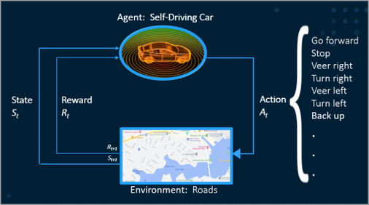
Reinforcement learning WRT Data Mining
Reinforcement Learning (RL) enables an agent to learn from experience (in form of reward and punishment for explorative actions) and adapt to new situations, without a teacher.
The model is not explicitly trained on any data. Instead, it learns by trial and error.
RL agent is able to learn to make decisions on the sampling of the environment which provides the data.
Data mining is the process of extracting knowledge from data. It is a process that involves finding patterns and trends in data that would otherwise be overlooked.
Eg: Predictive analysis, customer segmentation. Fraud detection

Slide 11
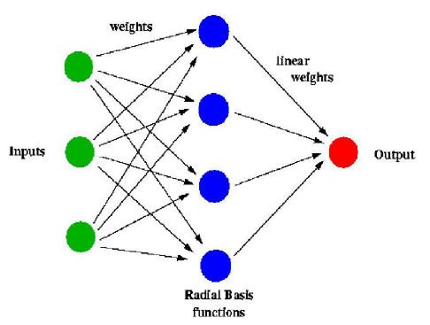
Machine learning
Machine learning is a subfield of artificial intelligence that focuses on the development of algorithms and statistical models that enable computers to learn and make predictions or decisions without being explicitly programmed.
It involves training algorithms on large datasets to identify patterns and relationships and then using these patterns to make predictions or decisions about new data.
Machine learning is used for a wide range of applications, such as regression, classification, and clustering.
Machine learning algorithms can range from simple linear models to more complex models such as decision trees and random forests.
The major aim of ML is to allow the systems to learn by themselves through experience without any kind of human intervention or assistance.

Slide 12
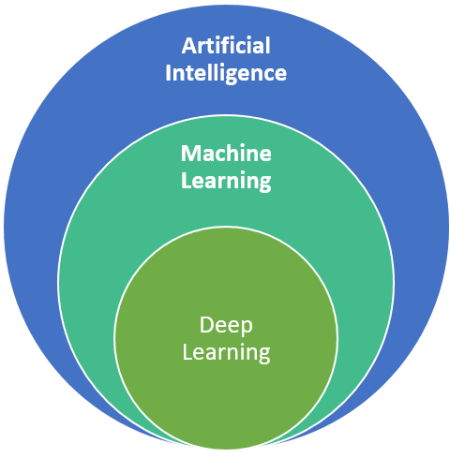
Artificial Intelligence
Artificial Intelligence is basically the mechanism to incorporate human intelligence into machines through a set of rules(algorithm).
AI is a combination of two words: “Artificial” meaning something made by humans or non-natural things and “Intelligence” meaning the ability to understand or think accordingly. Another definition could be that “AI is basically the study of training your machine(computers) to mimic a human brain and its thinking capabilities”.
AI focuses on 3 major aspects(skills): learning, reasoning, and self-correction to obtain the maximum efficiency possible.

Slide 13
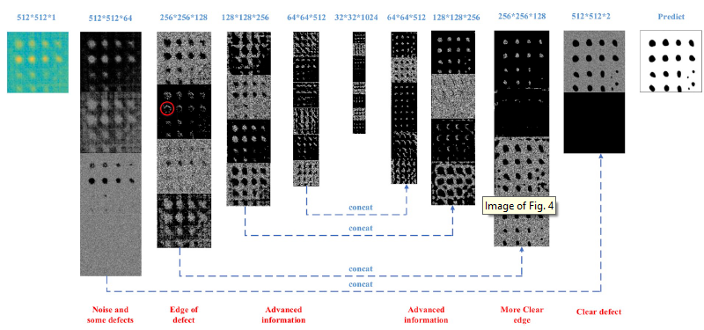
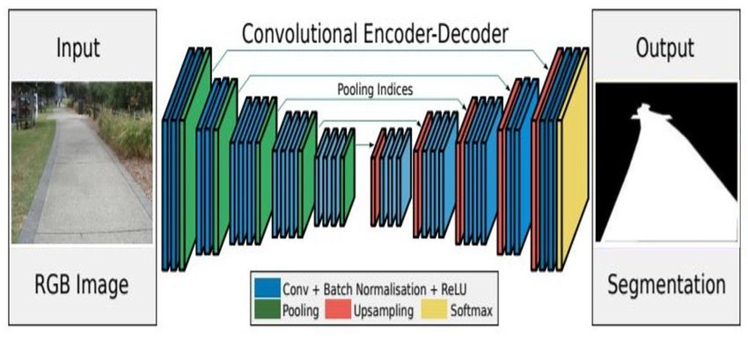
Deep Learning
Deep learning, on the other hand, is a subset of machine learning that uses neural networks with multiple layers to analyze complex patterns and relationships in data.
It is inspired by the structure and function of the human brain and has been successful in a variety of tasks, such as computer vision, natural language processing, and speech recognition.
Deep learning models are trained using large amounts of data and algorithms that are able to learn and improve over time, becoming more accurate as they process more data.
This makes them well-suited to complex, real-world problems and enables them to learn and adapt to new situations. Eg. FaceNet, DefectNet, SegNet etc.

Slide 14
Real time applications on AI/ML/DL/DS
Autonomous Vehicles: AI and ML technologies are at the core of autonomous vehicles, enabling real-time perception, decision-making, and control. These systems analyze sensor data, such as cameras and LiDAR, to detect objects, navigate roads, and make driving decisions in real time.
Virtual assistants: Virtual assistants like Siri and Alexa use AI to understand natural language and respond to user requests.
Risk assessment: AI and machine learning are used to assess risk in real time, such as the risk of a customer defaulting on a loan.
Healthcare: AI and machine learning are used to diagnose diseases, recommend treatments, and monitor patients in real time.
Manufacturing: AI and machine learning are used to optimize production processes, improve product quality, and prevent defects in real time.
Retail: AI and machine learning are used to personalize shopping experiences, recommend products, and prevent fraud in real time.
Financial services: AI and machine learning are used to manage risk, make investment decisions, and prevent fraud in real time.

Slide 15
Real time applications on AI/ML/DL/DS
Natural Language Processing (NLP) and Chatbots: AI and ML techniques are used to develop chatbots and virtual assistants that can understand and respond to natural language queries in real time. These systems enable businesses to provide instant customer support, automate repetitive tasks, and enhance user experiences.
Image and Video Recognition: AI and DL algorithms are used to analyze and recognize objects, faces, and scenes in real-time images and videos. Applications include facial recognition for security purposes, object detection in autonomous vehicles, and real-time video analytics for surveillance systems.
Fraud Detection and Anomaly Detection: ML and DS techniques are employed to detect fraudulent activities in real time, such as credit card fraud, insurance fraud, or network intrusion. By analyzing patterns and deviations from normal behavior, these systems can quickly flag and respond to potential fraud.
Predictive Maintenance: ML models can be used for real-time monitoring and prediction of equipment failures and maintenance needs. By analyzing sensor data and historical patterns, organizations can identify potential issues before they occur, optimize maintenance schedules, and reduce downtime.

Slide 16
Real time applications on AI/ML/DL/DS
Financial Trading and Algorithmic Trading: AI and ML algorithms are utilized in real-time financial trading to analyze market data, identify patterns, and make trading decisions. High-frequency trading relies on real-time data analysis and rapid decision-making to execute trades at optimal prices.
Recommendation Systems: Real-time recommendation systems, powered by ML and DL techniques, analyze user behavior and preferences to provide personalized recommendations in various domains such as e-commerce, streaming services, and content platforms.
Sentiment Analysis and Social Media Monitoring: ML and NLP techniques are used to analyze social media streams and real-time customer feedback to understand sentiment, monitor brand reputation, and detect emerging trends or issues.
In the healthcare industry: AI is being used to develop new treatments for diseases, diagnose diseases more accurately, and monitor patients remotely. For example, Google AI has developed a new AI system that can diagnose skin cancer as accurately as a dermatologist.

